Slide 1

ings
The Global Fund
to Fight AIDS, Tuberculosis and Malaria
A Unique International Organization
25 September 2026

Slide 2
I. Institutional features of the Global Fund
  Origins, establishment and initial arrangements
  Legal Team
  Select Legal Issues: Privileges and Immunities, etc.
  Governance landscape
II. Activities and operations
III. Funding, partnerships and procurement activities

Slide 3
I. Institutional Features of The Global Fund
1. Origins, establishment and initial arrangements
2001
      United Nations Resolution on Declaration of Commitment on HIV/AIDS: creation of a health fund distinct from the United Nations.
      Transitional Working Group: identification of the optimal legal design for the new organization given the urgent need to establish the Global Fund and initiate large-scale financial disbursements to fight the diseases.
      Dual-track approach: formation as a Swiss foundation & interim host relationship with WHO and clarification of the legal status of Global Fund by the Swiss Government over time.
2002
      Formal establishment of the Global Fund.
      Approval of the first round of grants.

Slide 4
I. The Legal Team & Institutional features of the Global Fund
The Legal Department consists of:
- Grant Management Legal Team
Country Portfolios/Regional – Language Requirements
- Institutional Legal Team
Procurement, HR/internal justice mechanisms, Treasury, IT
2. Privileges and Immunities
      Headquarters Agreement concluded in 2004 between the Global Fund and the Swiss Federal Council: recognition of the international juridical personality and legal capacity of the Global Fund in Switzerland.
      The Global Fund is designated in the US as a public international organization entitled to enjoy the privileges exemptions and immunities.

Slide 5
I. Institutional Features of the Global Fund and its officials
2. Privileges and Immunities
Under the P&I Agreement and bilateral agreements:
      The Global Fund is accorded juridical personality;
      Global Fund assets, income and property, wherever located, be immune from all forms of legal process;
      Officials, representatives of States and certain other persons are granted standard privileges and immunities;
      Privileges and immunities are granted to officials in the interest of Global Fund and not for personal benefit – The Executive Director is under duty to waive the immunity if it will impede justice and if it can be waived without prejudice to the purpose for which the immunity was granted.
      Today the Global Fund enjoy P&Is in some 32 countries and is recognized as an international organization by international organizations and institutions (UNGA, ILOAT, European Commission):
      Afghanistan, Belize, Benin, Burkina Faso, Burundi, Congo, Cote d’Ivoire, Djibouti, Ethiopia, Eswatini, Gabon, Georgia, Ghana, Kenya, Lesotho, Liberia, Malawi, Mauritania, Moldova, Mozambique, Niger, Rwanda, Sao Tome and Principe, Senegal, South Africa, Suriname, Togo, Uganda, Zambia, Zimbabwe, Switzerland and the United States

Slide 6
I. Institutional Features
3. Governance landscape
The supreme governing body is the Global Fund Board.
The Global Fund Board is composed of 20 voting members and 8 non-voting members.
Each member represents a constituency which could be composed of one (e.g., United States, or UK) or a group of countries (e.g., West and Central Africa).
In addition to the governmental constituencies, the civil society, the private sector and the private foundations are represented through constituencies of the Board. Constituencies are divided between a Donor Group and an Implementer Group.
Decisions require a 2/3 majority of the constituencies of both Groups.
95% of Global Fund resources come from governmental donations.

Slide 7
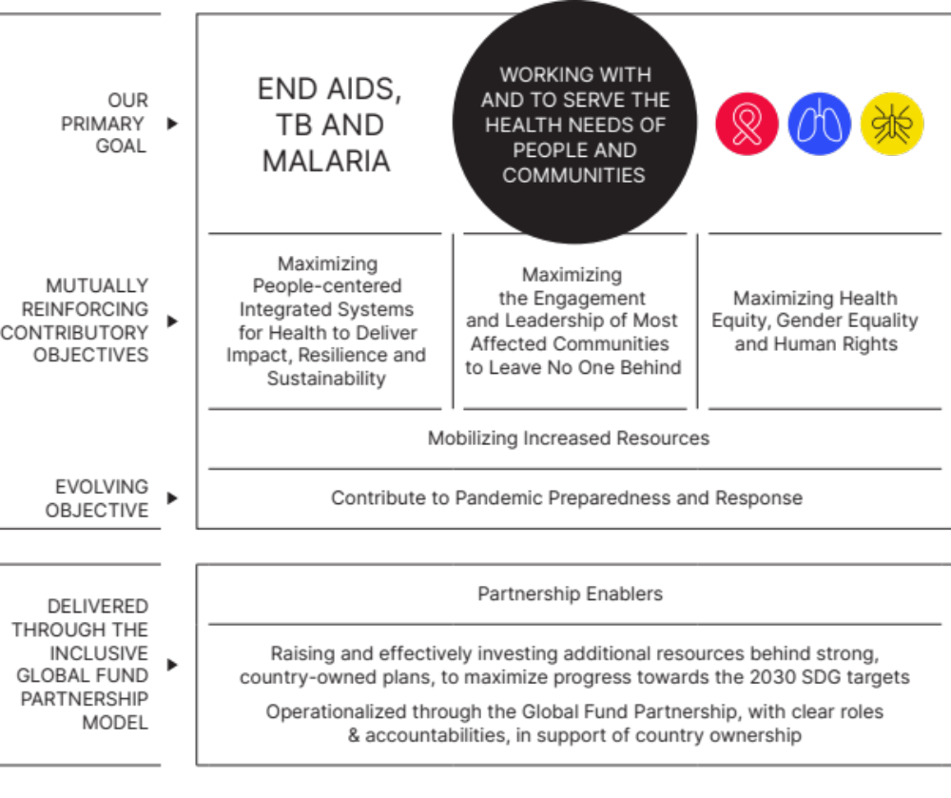
II. Grant Management activities and policy landscape
The Global Fund Strategy Framework 2023-2028
Strategy
Vision
“A world free of the burden of AIDS, tuberculosis and malaria with better, equitable health for all.”

Slide 8
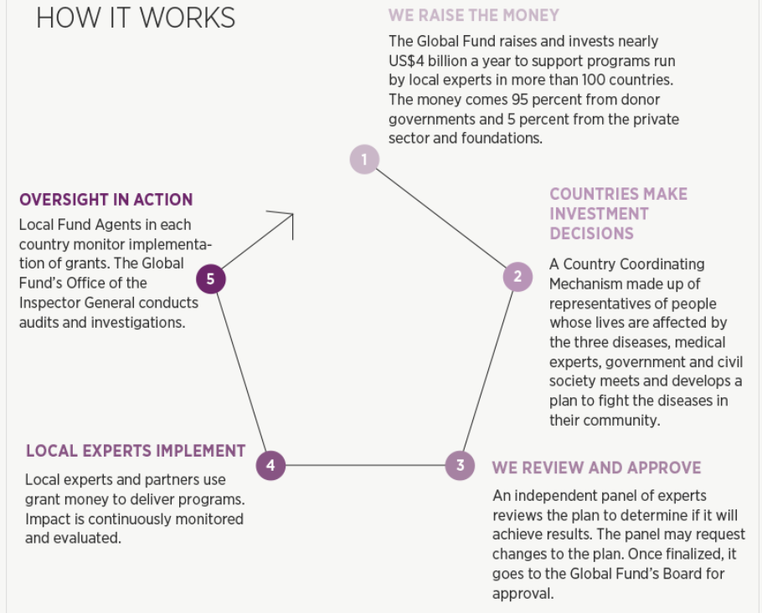

Slide 9
II. Activities and operations
Our grants have three-year implementation periods.
Our grant agreements are comprised of the: (a) Framework Agreement (which incorporate our standard terms and conditions); and (b) Grant Confirmation (detailing bespoke conditions).
        Examples of legal issues arising under grant agreements.
        Governing law, dispute resolution
Oversight is conducted by the Country Coordinating Mechanism, the Local Fund Agent, Auditors, the Global Fund Secretariat and the Office of the Inspector General.

Slide 10
III. Funding, partnerships and procurement activities
Funding landscape
Over 90% of the funding comes from public donors, with the rest contributed by the private sector, foundations, and innovative financing initiatives (USD 11.3 billion for the 8th Replenishment).
Public donors cannot earmark their contributions, whereas private donors are given such possibility.
Types of private contributions include:
      Cash Contributions (USD 1.3 billion for the 8th Replenishment).
      In-Kind Contributions (goods or services instead of cash)

Slide 11
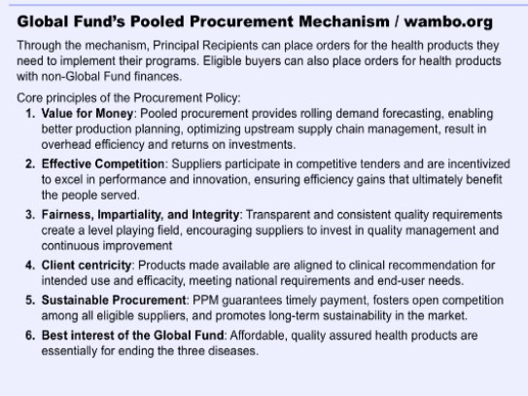
In 2025, US$ 1.02B in health products through pooled procurement
Procurement by Category
[in US$M, Pooled Procurement Mechanism]

Slide 12
Concluding remarks
The journey of the Global Fund reflects the example of a novel multilateral organization seeking to increase its efficiency and to maximize its impact while operating within certain confines of more traditional international organizations.
By and large, the journey has been a successful one:
      Health programs supported by the Global Fund partnership have saved 70 million lives;
      Overall, the number of deaths caused by AIDS, TB and malaria each year has been reduced by 63% since 2002 in countries where the Global Fund invests.

